Slide 1
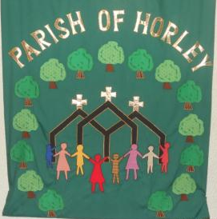
Profile of the Parish of Horley
“serving horley with the love of christ”

Slide 2
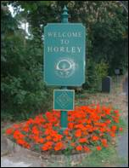
We are praying for…
As a Parish we are praying for a man or woman Team Rector to lead the Team Ministry in Horley, Surrey which comprises of the three churches of St. Bartholomew, St. Francis and St. Wilfrid. The ministry team consists of a Rector, a Vicar and, at present, two Curates together with a Youth Worker and Parish Administrator, both of whom work part time. This team provides for and nurtures the three churches and for the whole town.
It is a diverse and friendly parish and within these three churches there is a wide range of worship styles. You will need to be prepared to provide these styles to an average weekly congregation of between 40 - 80 in each of the churches.

Slide 3
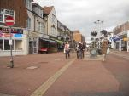
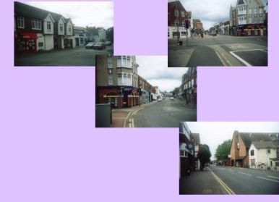
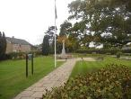
Our Thriving Parish
Horley is a growing town with a population of about 23,000 adjoining Gatwick Airport and close to the M23 and M25. It lies within easy reach of London, the south coast and the English Channel ports, with frequent regular train services the south coast, to London with simple, convenient changes putting the entire country within easy reach. The civil parish of Horley is in Surrey but the ecclesiastical parish extends into West Sussex and its boundary cuts across the runway of Gatwick Airport.
There are plans to build 2,600 new homes in two residential estates to the north-east and north-west of Horley. The north-east development is proceeding slowly in the light of the current financial situation. There are on-going discussions about one and possibly two new ecumenical Church primary schools as part of the new developments. These will have significant impact on our churches with an influx of young families..

Slide 4
The airport, with the industrial complexes in nearby Crawley, makes a large contribution to the economy of the town. The airport, though in the parish, has its own Chaplain provided by Chichester Diocese. Parish clergy have a role on the Sussex Emergency Team because of our location.
Unemployment is still comparatively low. About a third of Horley’s residents work in the town; another third work in Crawley or at Gatwick, and the remainder travel further afield to Reigate, Redhill and London. Many of those working locally are engaged in retail and service industries (e.g. catering, guest houses and hotels), financial services and light engineering.
There are many homes offering care for the elderly and for those with special needs. There is an active Town Council with residual powers and a busy Chamber of Commerce. Although many people commute to London, the town is essentially not part of the suburbs.

Slide 5
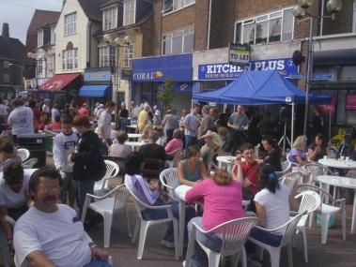
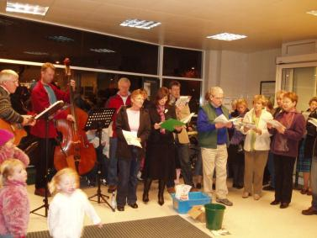
Our Community Outreach
The work of the churches is greatly appreciated by the Town Council and the Parish supports many activities of the Council in the town, such as St. George’s Day, Remembrance Day, the Autumn Fayre .
An Easter service is celebrated in the town centre and the three churches sing carols in the local Waitrose store every year.

Slide 6
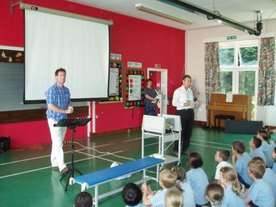
There are four infant schools, three middle schools and one secondary school, but no facilities for sixth form students. There are sixth form colleges in Redhill, Reigate, and Crawley, and church schools in Redhill, Dorking, and Crawley. The churches take a very active role in the Horley schools taking assemblies and providing Governors.
We currently help organise the Horley Schools Team with a termly ‘roadshow’ in assemblies. There have been regular prayer sessions before school for interested teachers in the secondary school.

Slide 7
Our Team Ministry
The Team Ministry was established in 1984 and revised in 2008. In addition to the permanent Rector and Vicar the Parish has, at present, the services of two active and mature Curates who work across the Parish. The churches embrace a variety of traditions in their services ranging from charismatic to liturgical, Common Worship including several informal styles and BCP. Any new incumbent would be expected to embrace these styles of worship.
Horley †eam Ministry
Serving Horley with
the love of Christ
One of the roles of the Rector will be to encourage those who wish to train for the ministry, and two ordinands from Horley are now serving in the North of England. In the past members of congregations have been employed as youth leaders, as administrators, and as an evangelist. Our present Youth Leader is a student at Oasis College but on placement with us.
“Come and join a great staff team in three lively churches as we seek the Kingdom of God in this growing town!”

Slide 8
Our Three Churches
Team working
Each church has its own worship teams, home groups and very active Sunday schools. While each church has its own worship style , we are working on growing our contributions across the churches. We hope this will include Growing Leaders and initiatives among our parent and toddlers groups this year
‘Serving Horley with the Love of Christ’
We have been implementing our Parish motto by participating in Horley-wide social events with town organisations. A wide variety of church and community organisations use the church premises. A constant challenge is how to use our premises to serve the community and draw people to worship. Our proposed new schools are designed to ‘serve Horley’. There is much more progress to make and many more opportunities!

Slide 9
As Rector you will work with the Team Vicar, the PCC and the three District Church Councils (DCCs) to develop Christian nurture, pastoral care and liturgy. In turn, the PCC encourages and supports the team. It is important that you should encourage existing groups and have a vision for future growth in all areas, in harmony with the Parish’s Mission Statement.
You will have outside involvement with the Diocese and the wider church. As leader of the team you will bring your particular gifts to the ministry and mission of the team as set out more fully in the Person Specification.
As leader of the team you will be responsible for developing and sustaining various aspects of church life across all three churches ,but may also be required to provide closer pastoral care for one of the churches. This role is changing as we continue to develop the Team’ model.

Slide 10
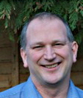
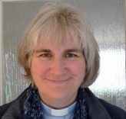
Our Staff Team
Our staff team is an import feature of clergy life as we pray together daily, plan, evaluate and think ahead. As the parish has moved from each church having a vicar towards more flexible team working, we need a colleague who will enjoy growing with us while bringing distinctive gifts. We minister across age and social spectrums but think that we need someone who will make a special contribution to growing family ministry in the years to come.
Our Curates:
Before ordination Doug trained
accountants and Kate was a
special needs teacher
Doug writes:
‘Each congregation is different in style, people and needs. Rotational ministry within a team has proven both supportive and challenging and requires a good memory and patience by us and the congregations!’

Slide 11
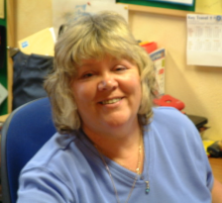
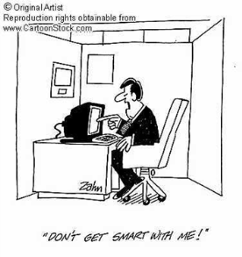
Ann, our Parish Administrator and part of the staff team organises our “hatching, matching, despatching and letting!“ She runs our office located at St.Bart’s on Monday and Friday mornings, but is otherwise operates as a mobile office by ‘phone and e.mail. She plays a great part in our pastoral life.
Ann says
“ I enjoy working in the team and providing the back up they need. They do need some organising at times!”
Are you happy with computers? IT plays a considerable
part in Parish administration;
St. Bart’s and St. Wilf’s use Powerpoint and SongPro
in most services and sermons.

Slide 12
Team working
The PCC has overall responsibility for the Parish. Each church has its own District Church Council (DCC) that looks after the affairs of their church. The Churchwardens of each church form a Standing Committee in between PCCs.
We use all forms of electronic media as much as possible to keep in touch!
Each church has its own worship teams, home groups and very active children’s Sunday activities. While each church has its own worship style and is relatively independent, we need to work harder to grow our contributions across the churches. We hope this will include Growing Leaders and initiatives among our parent and toddlers groups this year.

Slide 13
Ecumenical Fellowship
There is an energetic and thriving Ministers' Fraternal meeting monthly to pray together, including all the main denominations in the town – Anglican, Methodist, Baptist, Roman Catholic and independent evangelical and charismatic churches.
As Anglican Rector you will take a prominent role in these fraternal meetings.
The Fraternal has organised joint Alpha courses, evangelistic events on the streets and joint acts of worship - both public and within churches as well as pulpit exchanges. We expect this to continue and grow and we are striving for more congregational involvement.
There is also ecumenical support for the Women’s World day of Prayer

Slide 14
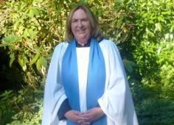
Lay involvement
Currently there is one Reader
in the Parish, Penny Lochead,
one retired reader and
another in training
Lay people are fully involved across the parish in many different roles including:
leading services
preaching
acting as intercessors,
Lay administration of Communion
All Age worship/family service planning
prayer & healing ministry assistance
cell group evangelism

Slide 15
Lay involvement
As well as the Sunday aspects of Lay involvement members
of the congregation work in the Parish to provide for:
home communion teams that serve individuals as well as local care homes
Running Mum’ and Toddlers groups
Mother’s Union meetings.
Members and non-members take part in Government consultations as part of a ‘rapid response’.
Ecumenical Lent Groups
Sally says
“Working as part of a small team I annually help organise ecumenical
Lent groups for around 100 from across all the church denominations in Horley.
Everyone enjoys learning and worshipping together”

Slide 16
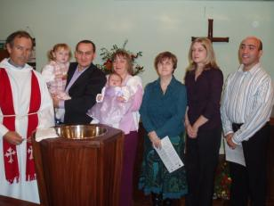
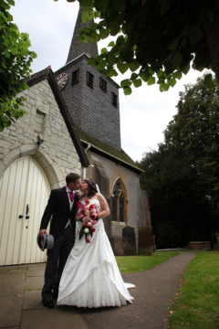
Baptisms and Weddings
We have an open Baptism policy that requires all parents to attend a baptism briefing followed by a visit by a baptism team member and one of the clergy. Baptisms take place in all of the churches.
Most marriages take place at St. Bartholomew’s Church, although both St. Wilfrid’s and St. Francis are licensed. The team clergy share responsibility for the services and there are a series of marriage preparation classes. For those couples that have been divorced but wish to re-marry, then marriage may take place at the discretion of the minister.
Alternatively a service of Thanksgiving is always offered.

Slide 17
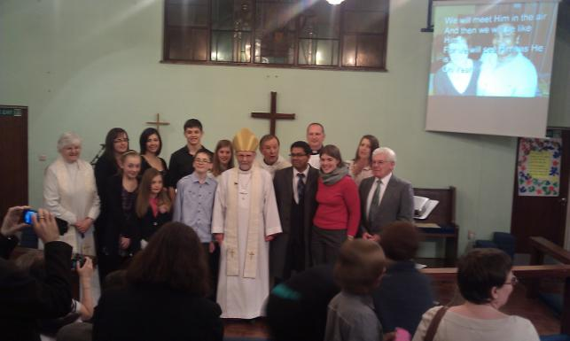
CONFIRMATION
Before Confirmation adults and children usually attend an Alpha or Teenage Alpha , Emmaeus, or Christianity Explored course.
This is followed by four additional confirmation classes.

Slide 18
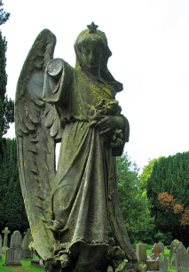
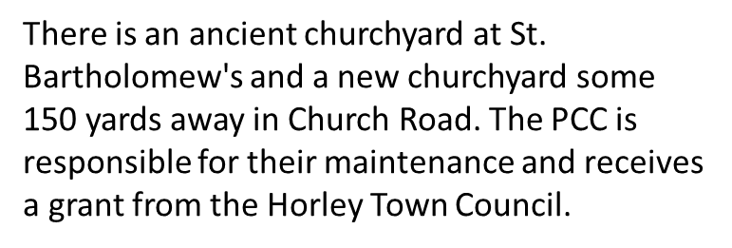
Funerals
While all three churches are licensed for funerals, most take place at the nearby Crematorium and burial services from St Bart’s Church. We hold an annual service with St Catherine's Hospice to which we invite all bereaved families. We hold ‘Living with Loss’ courses when we can. In 2010 there were 67 funerals or burials of ashes, shared among the clergy.

Slide 19
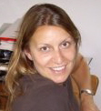
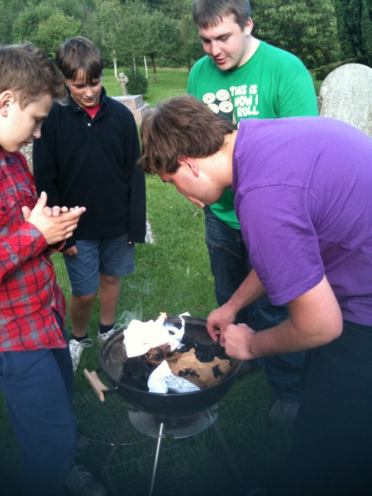
Youth Work
Kerry is our youth worker and she coordinates the youth work across the Parish
Kerry says : “Our parish children and youth work sees about 80 under 18s gather at various groups and events across the week.”
A group of adults and teenagers camps at “People without Limits” summer celebration on the Kent showground in Detling each year. www.peoplewithoutlimits.org
Other youngsters visit the Mid Wessex Christian Camp.

Slide 20
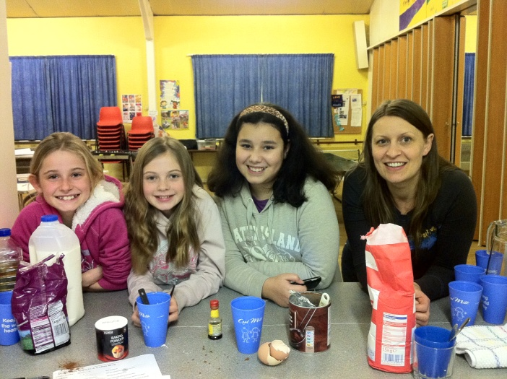
Youth and Children’s Work
We have a very active youth ministry
The 2nd Horley Boys Brigade and Girls Association (BB/GA) meet in two groups at St Wilf's on Mondays with Anchors ( Reception to Yr3) and Juniors (Yr3 to Yr7)
ID Youth (Yr7 to Yr10) Meet weekly, alternatively at St Wilfs and St Barts
Uber (6th Form+) Meet at St Francis House every other week
And an active afternoon MESSY church once a month.
for young people at St. Francis
And our Puppet Kru team who use puppets to bring the gospel to young people

Slide 21
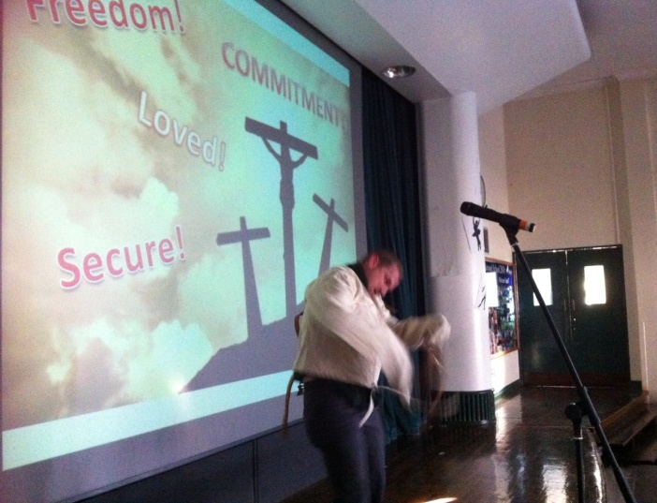
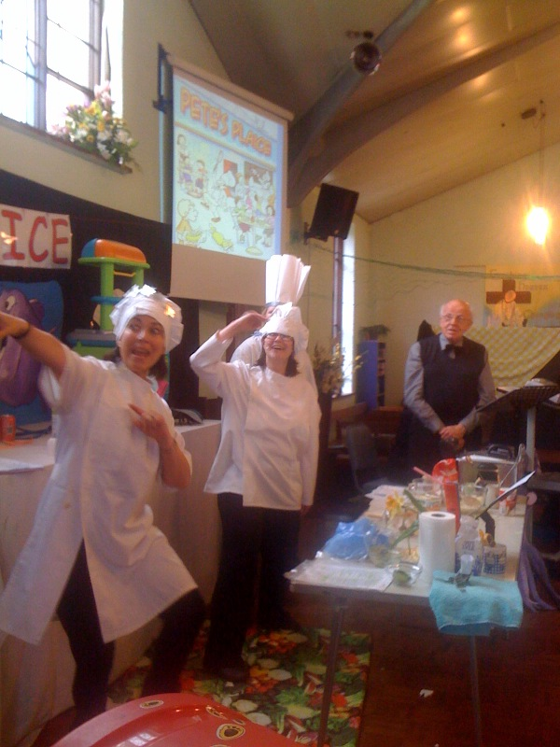
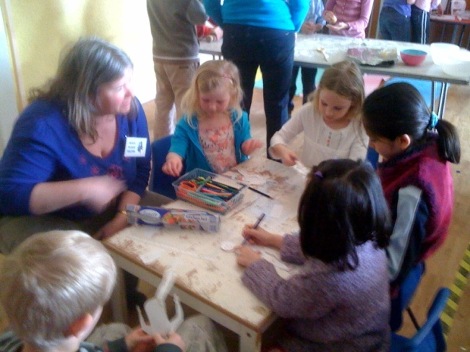
We support the Oakwood school with Assemblies, RE lessons and lunchtime workshops
In addition to our regular clubs we hold Easter holiday events, Christmas activities and there is opportunity for our young people to get involved with activities such as; Light Parties and Neon Discos, youth led services, summer BBQs, sponsored events, skate park trips, swimming and bowling.

Slide 22
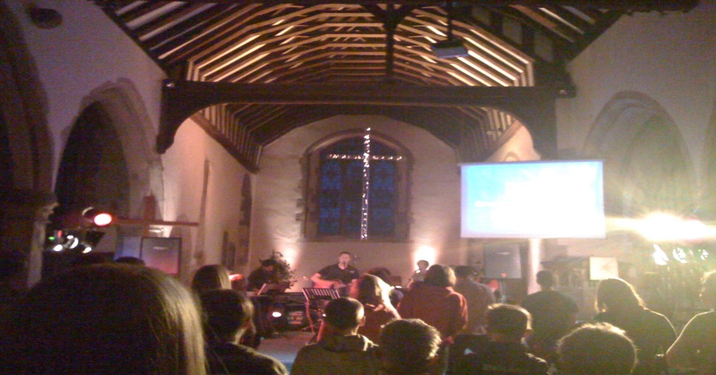
DEANERY
There is a regular meeting for youth workers from both the Deanery and our other town churches at a networking group we started this year. We are always involved in our Deanery Youth work and have been a large part of previous annual events. We currently store a caravan that can be hired by anyone in the Deanery if required.
And we support Praise Night which is an ecumenical young adult worship evening held every 6 weeks .

Slide 23
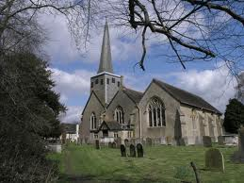
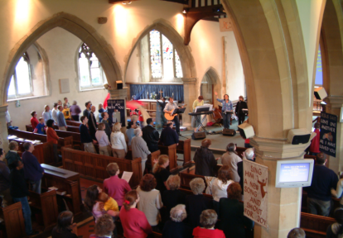
Our Three Churches
Barts
is a lively, modern 14th century parish church often filled to its capacity of over 200 at baptisms or carol services. There are services every Sunday with an average congregation of 80 adults and 20 children at the 10.45am Informal Morning Praise, Holy Communion, or All Age Worship services. 10-15 attend the weekly 8am Holy Communion (BCP) service.

Slide 24
St.Barts Mission Statement
Our services are designed to be accessible to the large number of visitors that we have. Some of these are just passing through Horley, whilst others are seeking a deeper spritual experience and encounter with God. Above all we aim to make newcomers feel welcome and relaxed.
Worship at the main 10.45 service is very informal and comprises mainly modern songs and the occasional traditional hymn. The worship band comprises keyboard, guitars, bass and drums, augmented by brass and woodwind as appropriate.

Slide 25
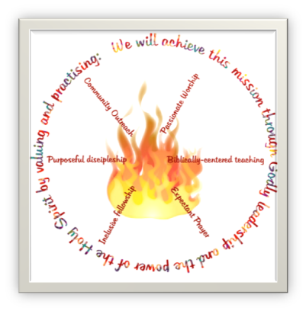
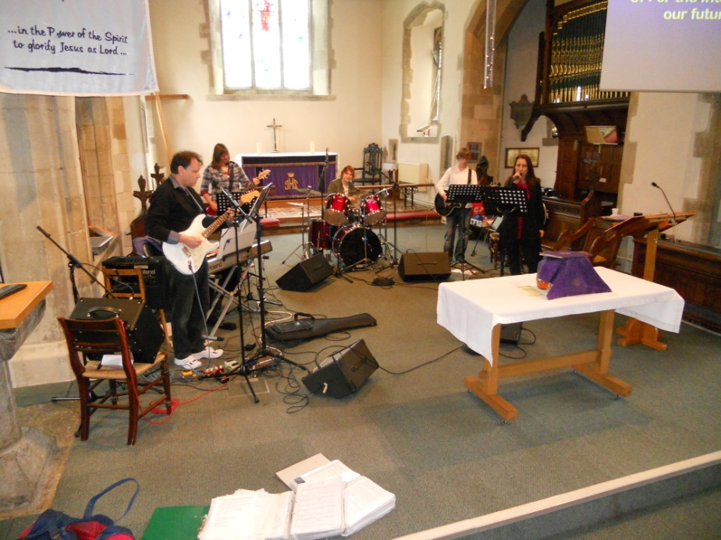
St. Barts was impacted by renewal in the late 1990s and members of the congregation (including clergy) have attended conferences at Toronto Airport Christian Fellowship and other charismatic churches. This has shaped the way in which we aim to live out the mission statement using the Values depicted in this diagram.
During the Summer a large number of the congregation attend the People Without Limits conference at Detling, in Kent. This conference is linked to St Luke’s Maidstone and Eric Delve has been to speak at Barts a number of times. The Detling worship band has also led Sunday Services.

Slide 26
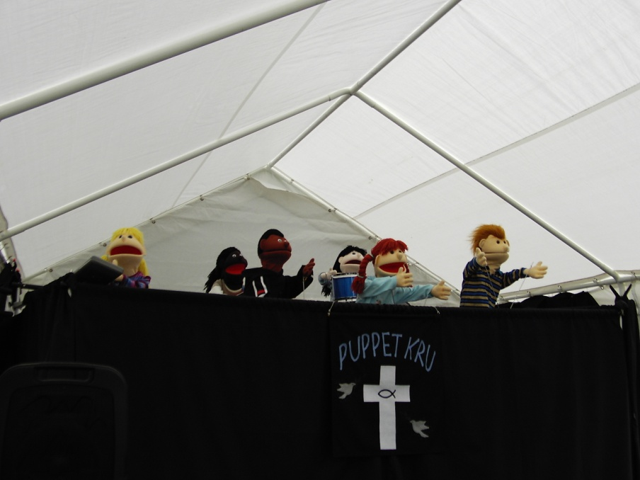
St. Barts has a thriving puppet ministry (‘Puppet Kru’) which is performed by both adult members of the congregation and a large number of our young people. They are present at our All Age services which often contain baptisms. The puppets are very popular, especially with the large number of visitors who come to these services.
Puppet Kru take their ministry to other churches and take part in outreach activities both in Surrey and wider afield.
Our Sunday School ‘Fusion’ is well supported and meets in our Upper Rooms.

Slide 27
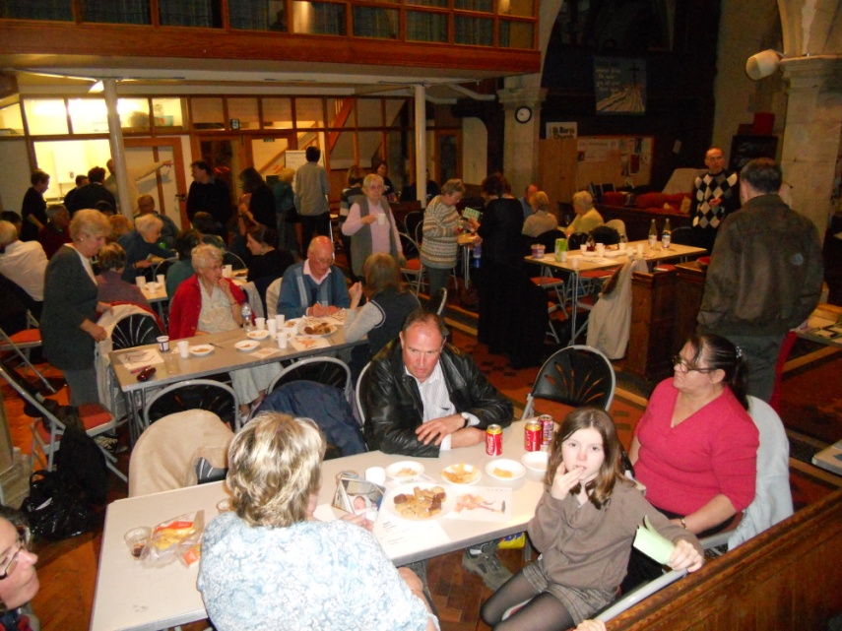
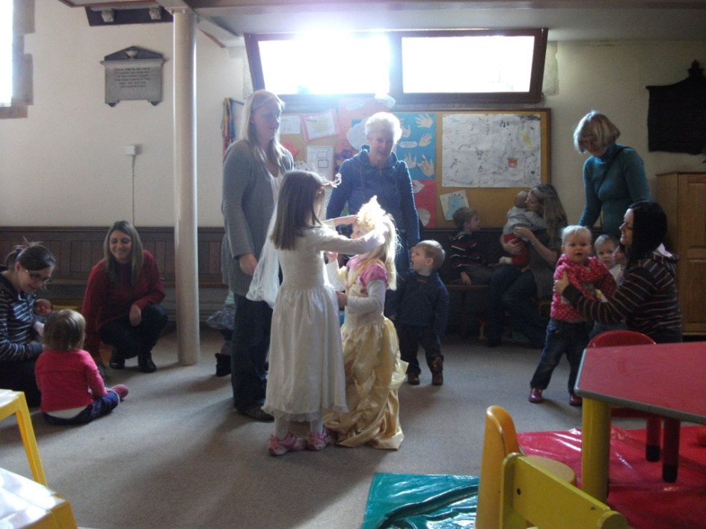
The interior of the church has recently been re-ordered to make it more flexible for both worship services and other events. The majority of the pews have been replaced by chairs and those which remain are moveable.
Activities which make use of the space include Good Seed (mums and toddlers), social activities, for example the recent quiz night pictured above, and Job Club.

Slide 28
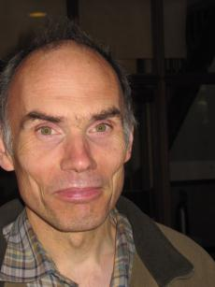
As well as the Sunday services, other activities at St. Barts include:
Good Seed – Mums and Toddlers
Wedding preparation
Living with Loss bereavement course
Job Club
Alpha – sometimes in co-operation with other Horley churches, eg Baptists
Youth Services
Light Party – an alternative to Halloween
Seder Meal on Maunday Thursday
Social activities, eg quizzes
Deanery youth nights
Street Pastors
Store cupboard providing food parcels
Jeff, one of the Churchwardens at St. Bart’s
says:
“We like to see our church buildings,
however old, in use throughout the week,
sometimes in very modern ways but which
all help the Kingdom of God grow.”

Slide 29
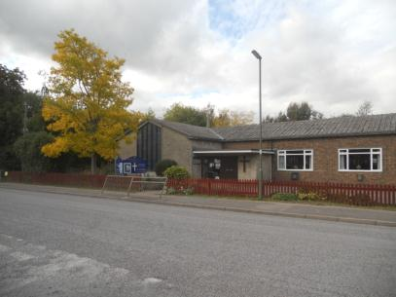
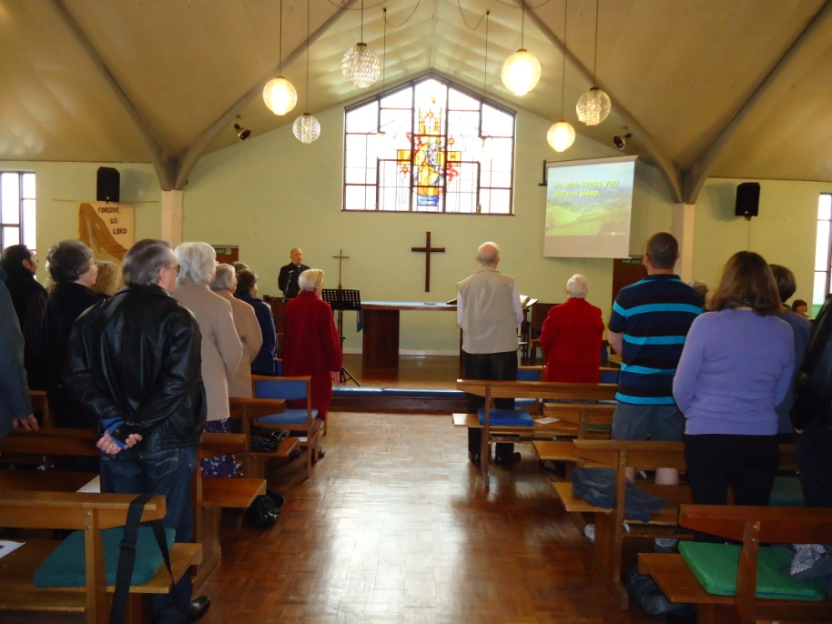
St. Wilfrid's
… was built in 1970 in the north of Horley and has a current capacity of 140, with a dual purpose hall, increasing to 200. The hall is flexible and able to split into two separate units and as well a side room that is used for smaller gatherings.
There are services every Sunday
at 9.30 am with Informal Morning Praise, Holy Communion, or All Age Worship with an average congregation of 45, and 15 children in very active
Sunday classes.
There is also a very enthusiastic music
team leading the services.

Slide 30
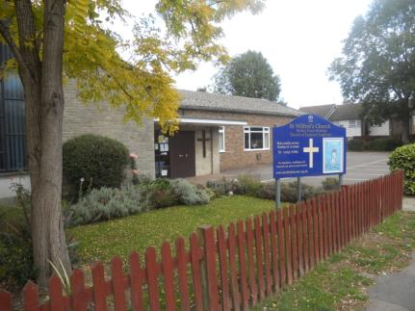
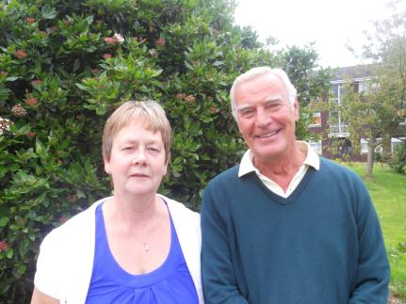
Margo and Peter
Our Churchwardens at St. Wilf’s
“We are pleased to be Churchwardens of a welcoming and family orientated church.
We have a friendly and involved fellowship with a heart for mission .”

Slide 31
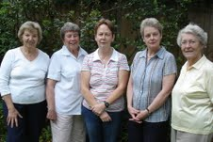
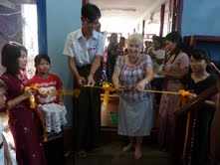
Mission
There is an active mission team that arranges events to support the mission giving.
Menet Is a local charity formed to support a past member of St. Wilfs who operates a school in Myanmar
Many fundraising events support the mission
work such as barn daces, quizzes and
beetle drives to which the neighbourhood
Is invited

Slide 32
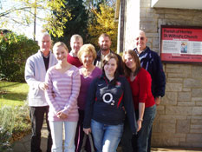
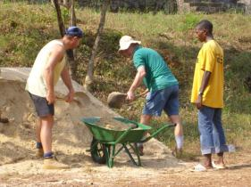
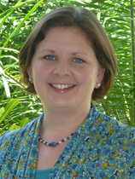
Mission
Teams from St. Wilfrid’s church have, on several occasions, worked as volunteers for short periods with Mission Direct in Sierra Leone.
And the church currently supports Alison Gill working with YWAM in Burundi.

Slide 33
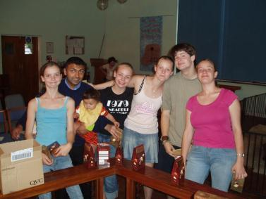
At St. Wilf’s there are youth clubs run in association with the BB/GA, that meet on Monday evenings and cater for children between the ages of four and sixteen.
There is an active church run Mum’s and Toddlers group every Tuesday morning with a community run Playgroup meeting on the other days.
Three different dance groups use the halls during the weekday evenings, and the Mother’s Union meet once a month.

Slide 34
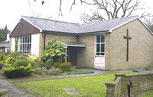
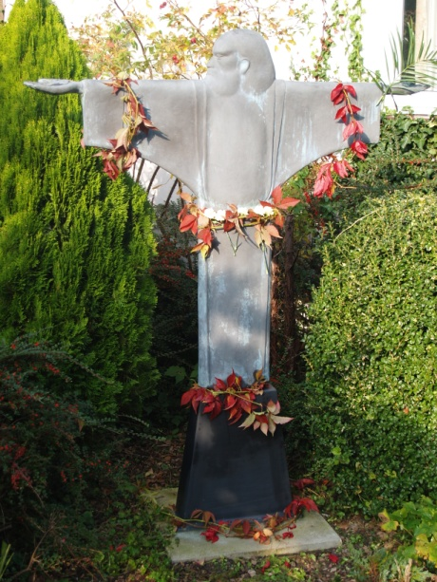
St Francis
St. Francis’ Church was built in 1958 to provide a place of worship on the east of Horley. The present building has a capacity of 75 with a dual-purpose hall increasing it to 200. It also has two separate rooms that are used for smaller gatherings.
Every Sunday there are services at
10.15 am for Family Service, Holy Communion, or Morning Prayer and an evening Compline.
Every third Sunday there is Messy Church at 4 pm, an Evensong at 6 p.m. once a month and a Taize service once every 3 months .

Slide 35
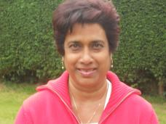
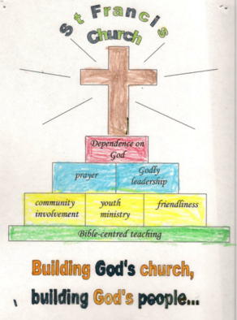
Worship is usually led by a small but dedicated group of musicians and singers, but at Christmas the adults and children are all encouraged, together with friends from other churches, to join an impromptu choir which leads our service of lessons and carols.
Tara and James, Churchwardens at St. Francis’
comment:
“Our friendly church offers a wide range of different services and styles. We aim to reach out to all of our local community and try to make sure that every one receives a warm welcome and feels included and at home.”

Slide 36
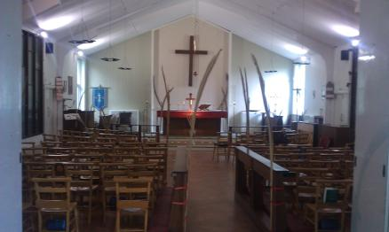
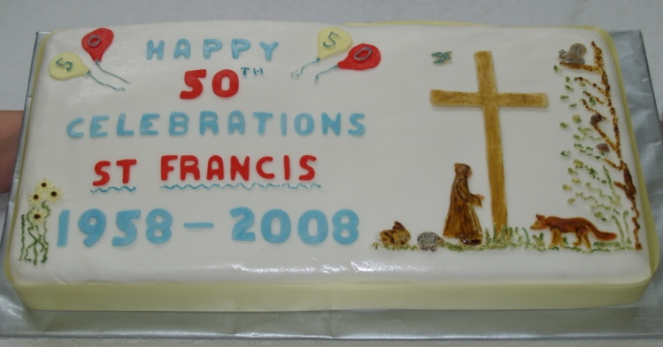
Each month the church tithes to a charity
During Lent, we hold soup lunches on a Saturday to raise money for the Bishop’s Lent appeal. These are a great social occasion and a good way to learn some new soup recipes.
In 2008 we celebrated the church’s 50th anniversary with a weekend of celebrations

Slide 37
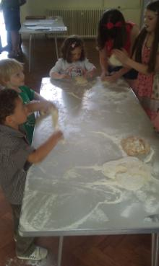
Every third Sunday at 4 pm we have a Messy Church that offers a more informal worship and activities, and is designed to encourage families with young children to come and join us.
On the Sunday nearest St Francis day, we hold a “Blessing of Animals” service which is held outside (weather permitting).

Slide 38
At St Francis’ we welcome Rainbows, Brownies and Guides on Monday evenings, and children’s dance classes on three nights of the week.
A thriving Mums and Babes group celebrated its 30th birthday earlier this year. The Group which is run by church members meets every Wednesday, with Toddler Praise services once a month. “Bobtails” run a Play School the rest of the week. Many other local community groups use our hall including the Beehive Quilters once a month.

Slide 39
Other Parish Services
Every Wednesday there is a service of Holy Communion (CW/BCP) - alternately at St. Bartholomew’s, St. Wilfrid’s and St. Francis’
On fifth Sundays we have a joint service of worship at each church in rotation as a sign of our Parish unity.
There are extra services on some Festivals and occasional civic services.
Robes are worn for all special services, BCP, Communions and at weddings and funerals. Robes are worn for all services at St Francis’ and often at St. Wilf’s but are not usually worn for the main services at St. Bart’s. Sometimes just scarves
are worn for Holy Communion at the discretion of the minister..

Slide 40
The Rectory
The Rectory is a large four bedroom,
two reception house located near the
centre of Horley and mid way
between all three churches.
It has a garage and small garden.

Slide 41
The person we seek …
RESPONSIBLE TO: The BISHOP of Croydon
You, our new Team Rector, will play a full part in the staff team which oversees the work of the parish. You would:
Through relationships - with the staff team you will:
Hold weekly staff meetings and daily morning prayers, playing a full part in developing the whole parish spiritual growth
Be flexible to grow and change as the shape of the work develops
Through relationships - outside the Team you will:
Attend Diocesan, Deanery and Clergy events and participate in MDR and CMD cascading training and information as necessary
Discover and develop your part in ministry to schools and in the town.
Attend Fraternal meetings with leaders of other Horley churches
Be on call in case of emergency at Gatwick Airport and participate in annual Emergency Training

Slide 42
The person we seek … continued
Leadership
Conduct worship services on a rota basis across all three churches with a range of worship styles
Work across a range of ages and circumstances and make a particular contribution to young families
Affirming the contributions and skills of the congregation, working with them to maintain and develop their input into the life and work of all the churches
Encourage and enable church members to live an evangelistic lifestyle
Conduct weddings, baptisms and funerals as required both in the churches and at the local crematorium
Liaise with and support groups inside and outside the church – for example Boys’ Brigade, Youth groups, Chamber of Commerce
Management and Administration
Responsible for the administration of the parish making full use of up-to-date IT
Chair or attend committee meetings in all three churches as required

Slide 43
Useful information
For links to our three churches:
www.horleyteamministry.org.uk
Our ecumenical partners:
www.churchesinhorley.org.uk/
www.horleymethodistchurch.org.uk
www.horleybaptist.org.uk
www.southlands.org.uk
www.leestreetchurch.org/
Civic and educational partnerships:
www.horleysurrey-tc.gov.uk/
www.horleychamberofcommerce.co.uk
http://www.reigate-banstead.gov.uk/council_and_democracy/our_borough/your_area/horley/horley_regeneration/horley_masterplan/index.asp
www.horleylp.org.uk

